Slide 1




AI in the Workplace
II
https://wmgmm.github.io/thematts/workshop.html
Starring Dr. Matt Mort & Matt Hayden

Slide 2
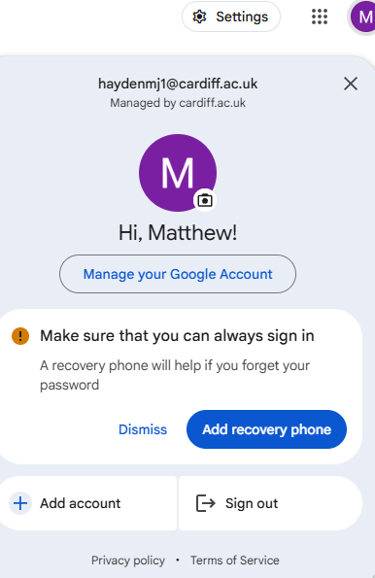
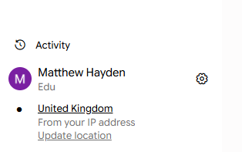
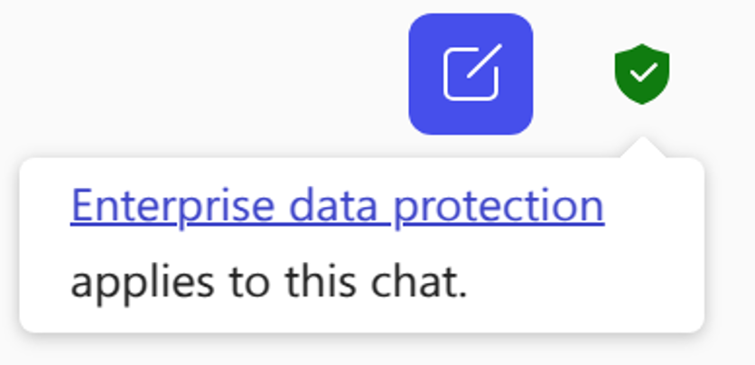


Staying safe
Always sign in with your work account for enterprise level protection
Copilot
Gemini
Remember:
InPrivate or
Incognito window

Slide 3
Mix and Match
Consider these as two tools best used together.
Each can give a second opinion on the work of the other (remember you would be the third opinion!)
Tools have usage limits – work best by sharing the load.

Slide 4

The Workshop brief
We’re looking at using AI tools to generate value-added resources from an existing document.
Demonstrating how AI can accelerate and augment content development by creating complementary materials that support learning, engagement and implementation.

Slide 5
Workshop tasks and topics
AI tools used:
Deep research
Image generation
Canvas
Gemini notebook
The topics:
Using AI locally on device
Moving from prompts to workflows

Slide 6
Responsible AI
When using AI in your work ALWAYS remember:
AI augments work under your guidance
Stay safe: If its for work then log in to your work account
Your work is your responsibility. Check those outputs!
Keep those job skills sharp – or loose the ability to check!

Slide 7

Deep research
What is Deep Research?
Unlike a chatbot which gives a quick answer, deep research browses hundreds of websites and your own files to build a comprehensive report.
Autonomous Browsing: It explores the web iteratively, following leads independently.
Synthesis: Organises findings into a structured report with full citations and source links.
Transparency: It shows its "thought process" and research plan before it starts.

Slide 8
Our research brief:
Explore how leading universities, public bodies and major organisations are cutting carbon by reducing demand at the source.
Compare Cardiff University's Demand First approach with real-world examples of smarter travel, leaner procurement, shared resources and behaviour change
Uncover the policies, nudges and data-driven interventions that are delivering measurable results before technology or offsetting even enters the conversation

Slide 9
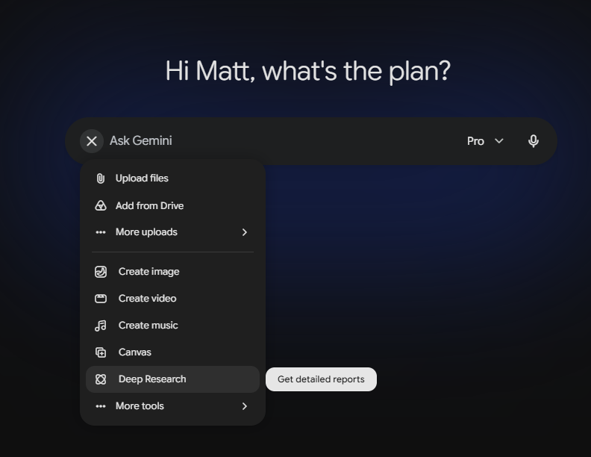
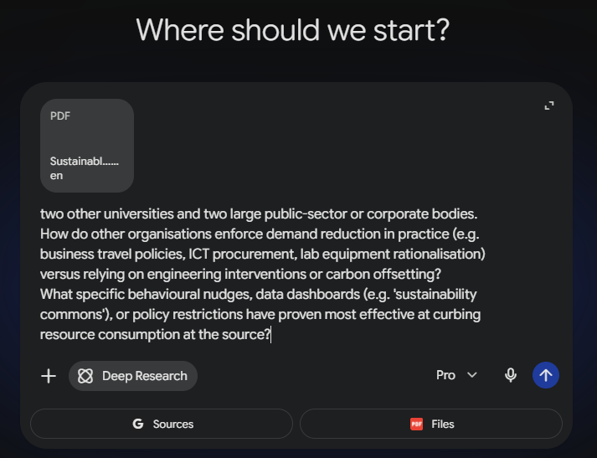
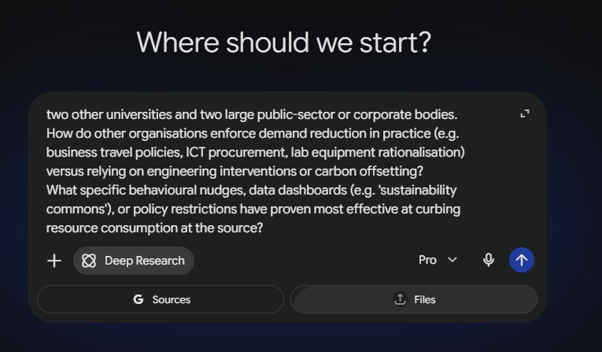
Deep research
1
3
2

Slide 10
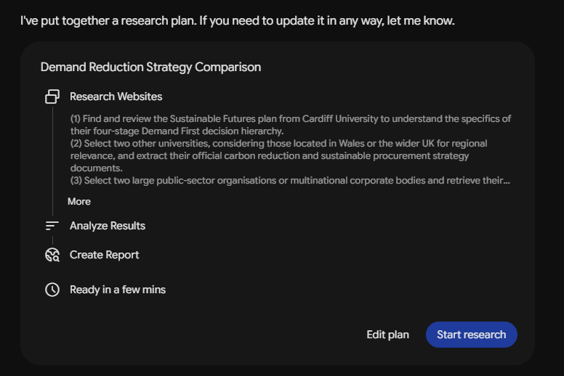
Deep research

Slide 11
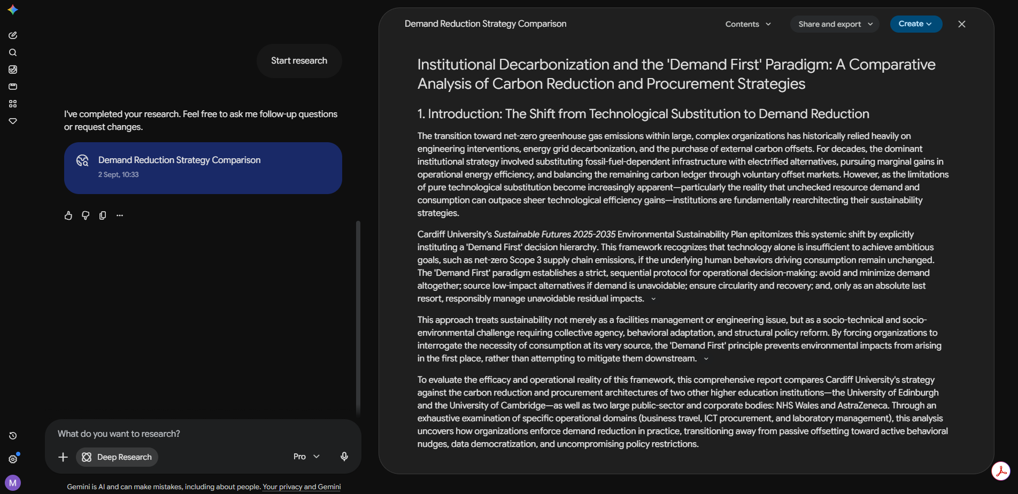
Deep research

Slide 12

Copilot top and tail
Fact check the document
Add any additional research
Generate a ‘new report’.
Run a quality control
Have an appendix that details changes from the original

Slide 13
Image Generation
NB: Using copilot for the exercises but these tips are model agnostic
When generating material for broachers or online teaching it’s handy to have consistent imagery.
Reverse engineering: Turn an existing source into a prompt that recreates its style, structure or content.
Style guide: Set rules and guidelines to keep your content generation consistent.
Accessibility audit: Does your description really match the image?
Not being negative: using the right terms for the image you want

Slide 14
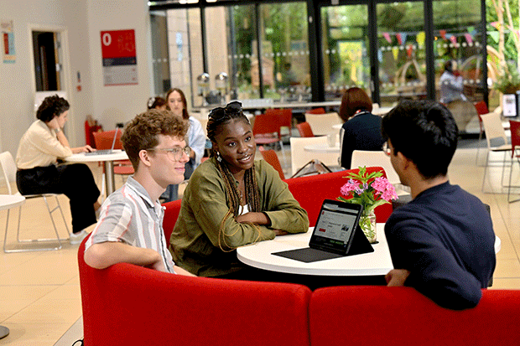
Reverse engineering
"Describe this image as a generation prompt. Break it into subject, composition, camera or perspective, lighting, colour palette, illustration style, and mood. Then give me a reusable template version with the subject left as a placeholder."
NB: Using copilot for the exercises but these tips are model agnostic

Slide 15
Style guide
Ask Copilot to write you a reusable style block: a fixed paragraph specifying palette, line weight, perspective, background treatment and character description. Then generate every asset with that block pasted at the top and only the subject line changing. Where the tool supports it, feed a previously generated image back in as a visual reference to lock the look.
NB: Using copilot for the exercises but these tips are model agnostic

Slide 16
Accessibility Audit
Generate an image, then open a new Copilot chat, upload your image, and ask:
"Describe this image for someone who cannot see it. What is the main message? What might be ambiguous or misleading?“
If the description does not match what you intended, the image has failed, and it would have failed for a screen reader user too.
And a handy way of starting a new image prompt
NB: Using copilot for the exercises but these tips are model agnostic

Slide 17
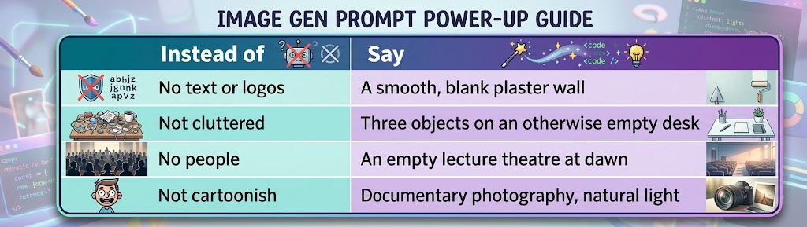
Don’t be so negative
Demanding an exclusion often summons the thing.
"No text on the wall" Gives .. You guessed it text on the wall
The model weights the noun, not the negation.
NB: Using copilot for the exercises but these tips are model agnostic

Slide 18

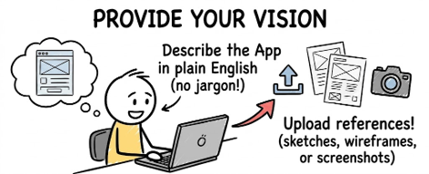


Canvas
Interactive workspace creates working web apps, presentation decks and polished documents.
Now for a bit of basic vibe coding…
Generate a functional 8-bit mini-game. Where a character navigates a university dining hall to collect low-impact foods while dodging high-carbon options.

Slide 19
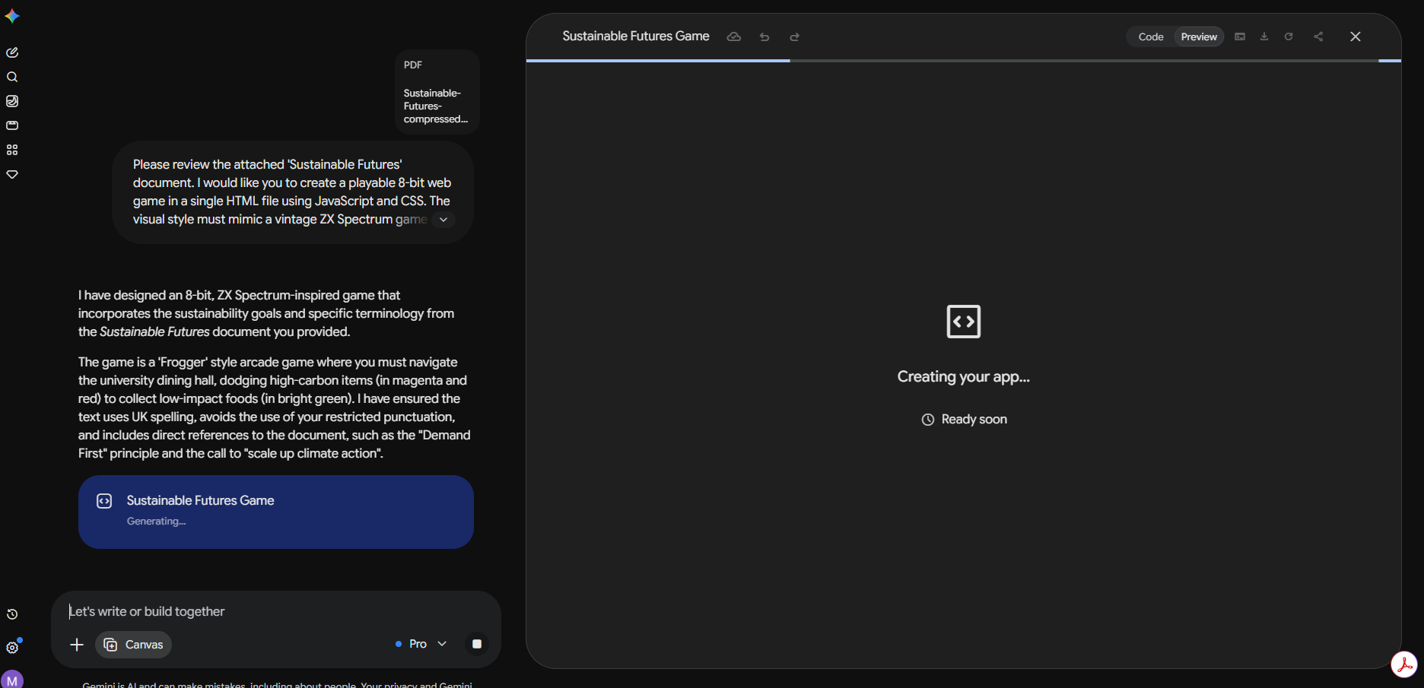
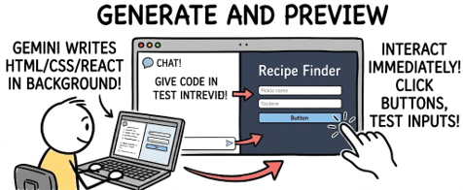
(Hint: You can check the code with
this tab when its created)

Slide 20
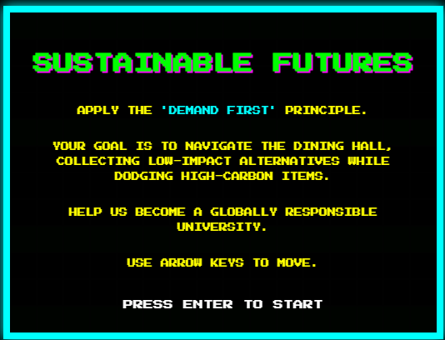
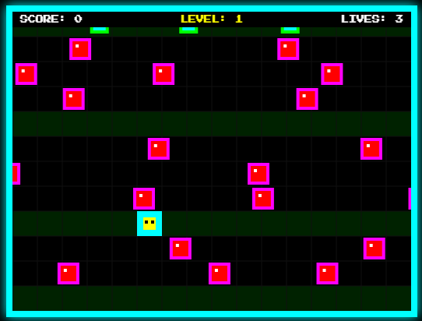
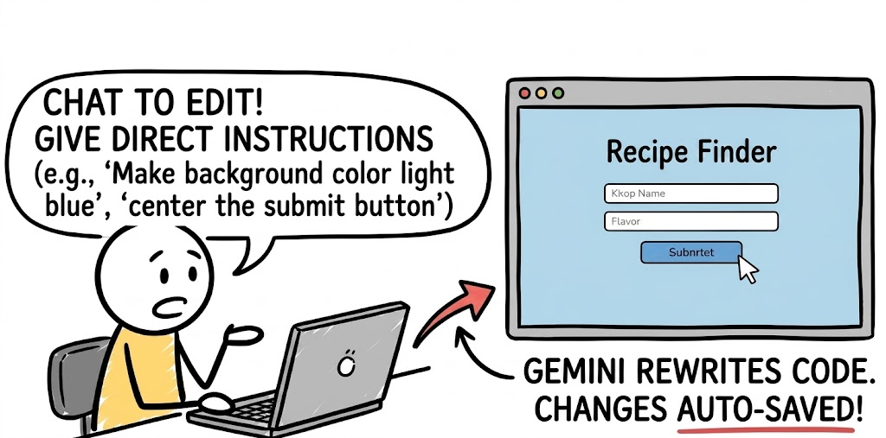
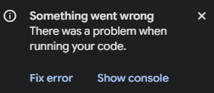
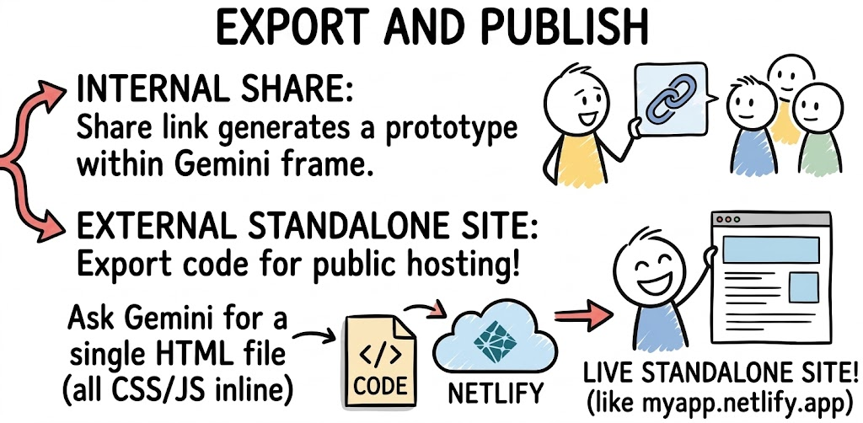

Canvas
So, you have your game – and its probably not perfect.
I had to ask it to slow down its frogger style game and add a ‘rest lane’

Slide 21

Skills
Copilot + Gemini
A skill is a workflow written down: a small markdown file.
Attach it in Copilot or Gemini, or paste it into Notebook.
Repeatable, shareable, and your judgement is in the file.
Five in today's pack, on the exercise pages.
[OPTIONAL] Write your own, from any task you repeat.

Slide 22
The Module
Gemini or Copilot
Download the training skill and the plan from the website.
Paste the prompt, attach both files, send.
Review and augment: the gap note is where to look.
[OPTIONAL] Run it in the other tool and compare.
Responsible AI: the human value is in the review.
Website: Exercise 04 https://wmgmm.github.io/part2/

Slide 23
Gemini notebook
Notebook
New notebook. Add your training PDF, or the site's backup.
Slide deck: paste Cardiff_Brand_SKILL.md as the description.
Generate. Notebook builds the deck to the skill.
[OPTIONAL] Second run with TheMattsBrandSkill.md. Compare.
Responsible AI: internal only. Public-facing is a human job.
Website: Exercise 05 https://wmgmm.github.io/part2/

Slide 24
The Dashboard
Gemini Canvas
New chat, Canvas on, attach the CSV, paste the build prompt.
Open ours and run yours beside it. Do they agree?
Verify and repair in the same chat, reattaching the CSV.
[OPTIONAL] Cleaner audit: a new chat, your HTML and the CSV.
Responsible AI: check the numbers before you tell the story.
Website: Exercise 06 https://wmgmm.github.io/part2/

Slide 25


How have your experiments been going?

Slide 26



AI does not scale through better prompts
INDIVIDUAL EXPERIMENT
GOVERNED WORKFLOW
People
Information
AI + tools
Human decision
Service outcome
Person
Prompt
Output
Repeatable, accountable and measurable.
Useful, but variable. Different inputs, checks and judgement produce different results.

Slide 27
Community – end?

Slide 29
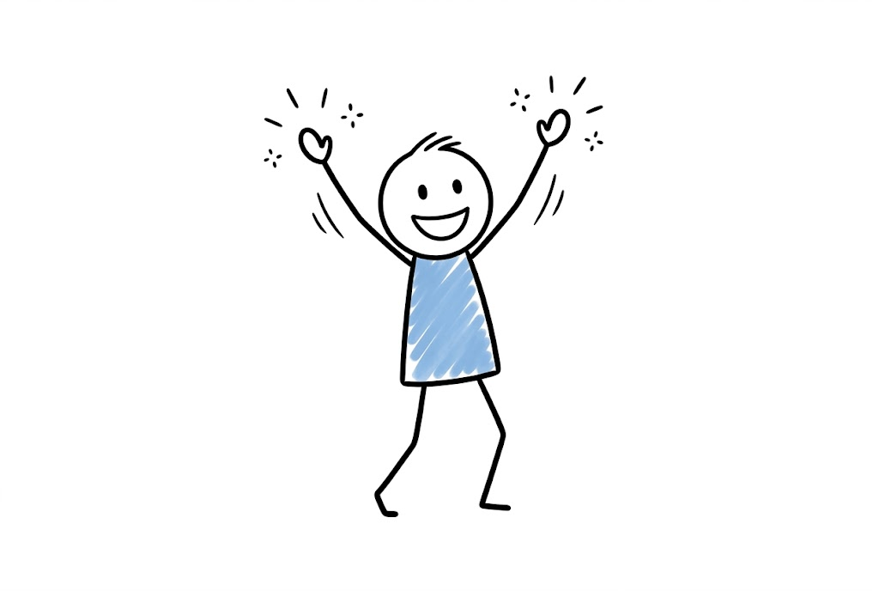
Think Workflow not Prompt
Even with a standardised prompt different users supply different data, apply different checks and use the output differently
An AI-enabled workflow is a defined piece of work in which people, information, an AI tool, conventional software and controls combine to produce an outcome.

Slide 30
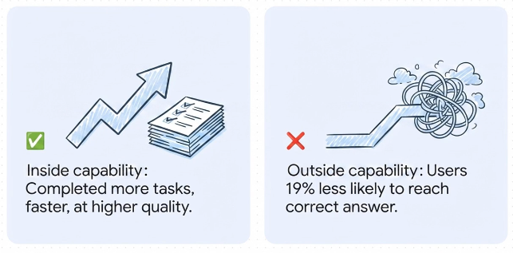
Question one: Is the task within AI capabilities?
Consultants using AI on a task outside its capability did substantially worse than colleagues with no AI at all.

Slide 31
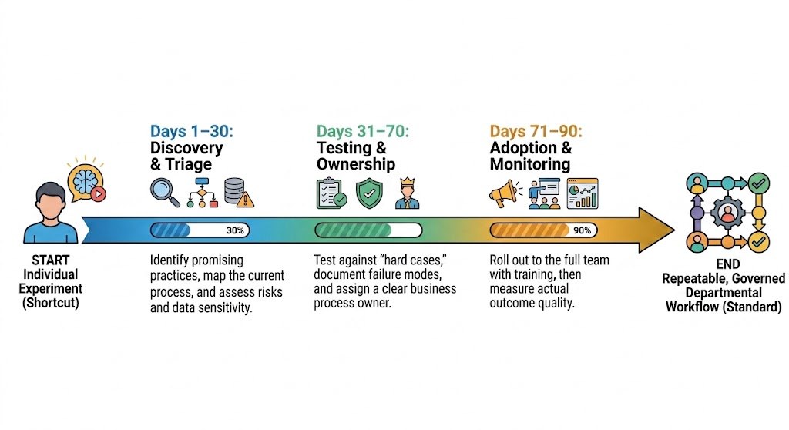
Think Workflow not Prompt

Slide 32
1-30
Discovery and Triage
Capture the opportunity >> Map the workflow >> assess value and risk
Record what the chosen task is and its current pain point - Save input/output examples (what good looks like)
Map old and new workflow steps, identify human decision points, approve data sources, describe quality checks before output is shared
What is the data sensitivity and consequence of errors? Level of Human involvement, Scale, ability to verify outputs
Use-case record > Workflow map > Risk classification
Notes:
Content adapted from gates 6 and 7 in Scaling_AI_from_Experiment_to_Standard_Practice.docx. Clean horizontal layout with top third intentionally blank.

Slide 33
31-70
Testing and Ownership
Evaluate real cases >> Assign controls and owners
Define acceptance criteria, confirm data, security and retention
Run repeated, representative trials - Test difficult and failure cases!
Assess usability and human factors, check operational fit and compare value against the baseline
Business owner accepts accountability. Data owner confirms permitted use
Specialists review applicable risks and impacts
Team lead covers training and wellbeing
Use-case record > Workflow map > Risk classification
Notes:
Content adapted from gates 6 and 7 in Scaling_AI_from_Experiment_to_Standard_Practice.docx. Clean horizontal layout with top third intentionally blank.

Slide 34
71-90
Adoption and Monitoring
Train and embed >> Review, improve or retire
Train the whole task and verification and publish a one-page workflow card
Provide realistic practice and manager support
Retain a safe non-AI route where needed
Measure outcomes rather than usage quotas – avoiding gaming behavior
Review performance and incidents - record any material process or system changes
Retest after significant change
Invite user and worker feedback
Improve, restrict, suspend or retire
Live workflow – trained team > Monitoring record
Notes:
Content adapted from gates 6 and 7 in Scaling_AI_from_Experiment_to_Standard_Practice.docx. Clean horizontal layout with top third intentionally blank.

Slide 35

Avoid gaming behaviour
Self-reports are unreliable in a known direction. A department that evaluates a workflow by asking people whether it helped will get a positive answer almost regardless of the truth.
Timed comparisons on real tasks are not expensive, and they are the only thing that settles it.
Time saved is not the same as value delivered. Any measure of effort should include verification and rework time, not just drafting time

Slide 36
Community – end?

Slide 37
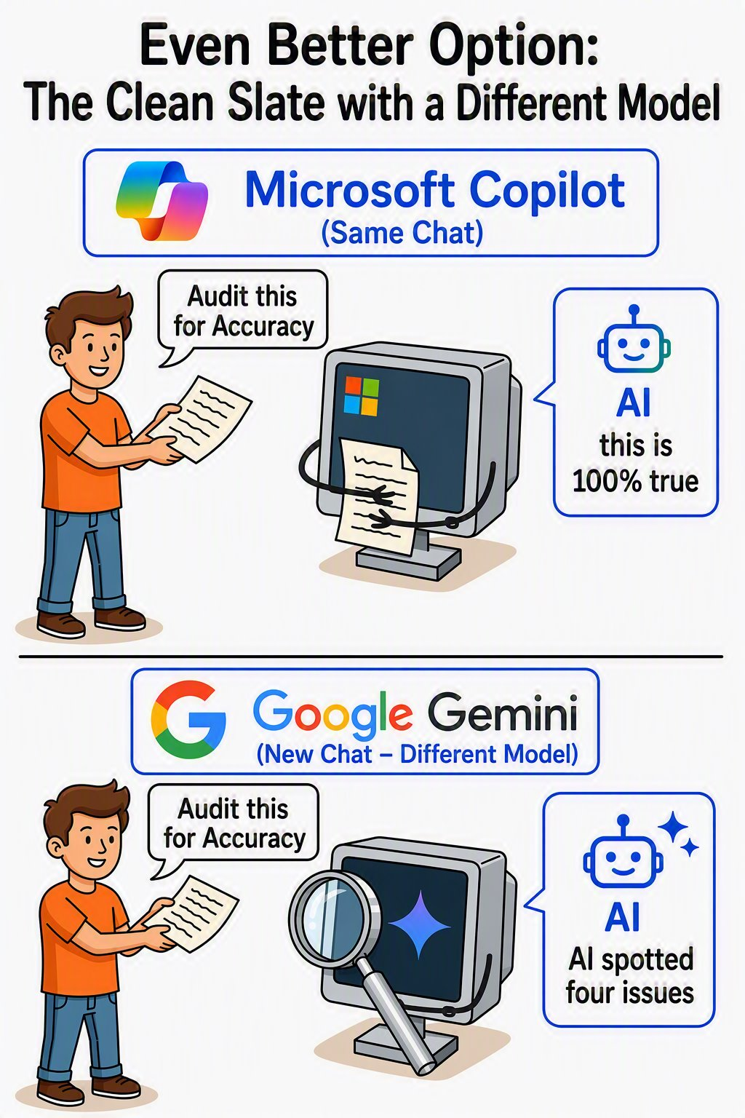
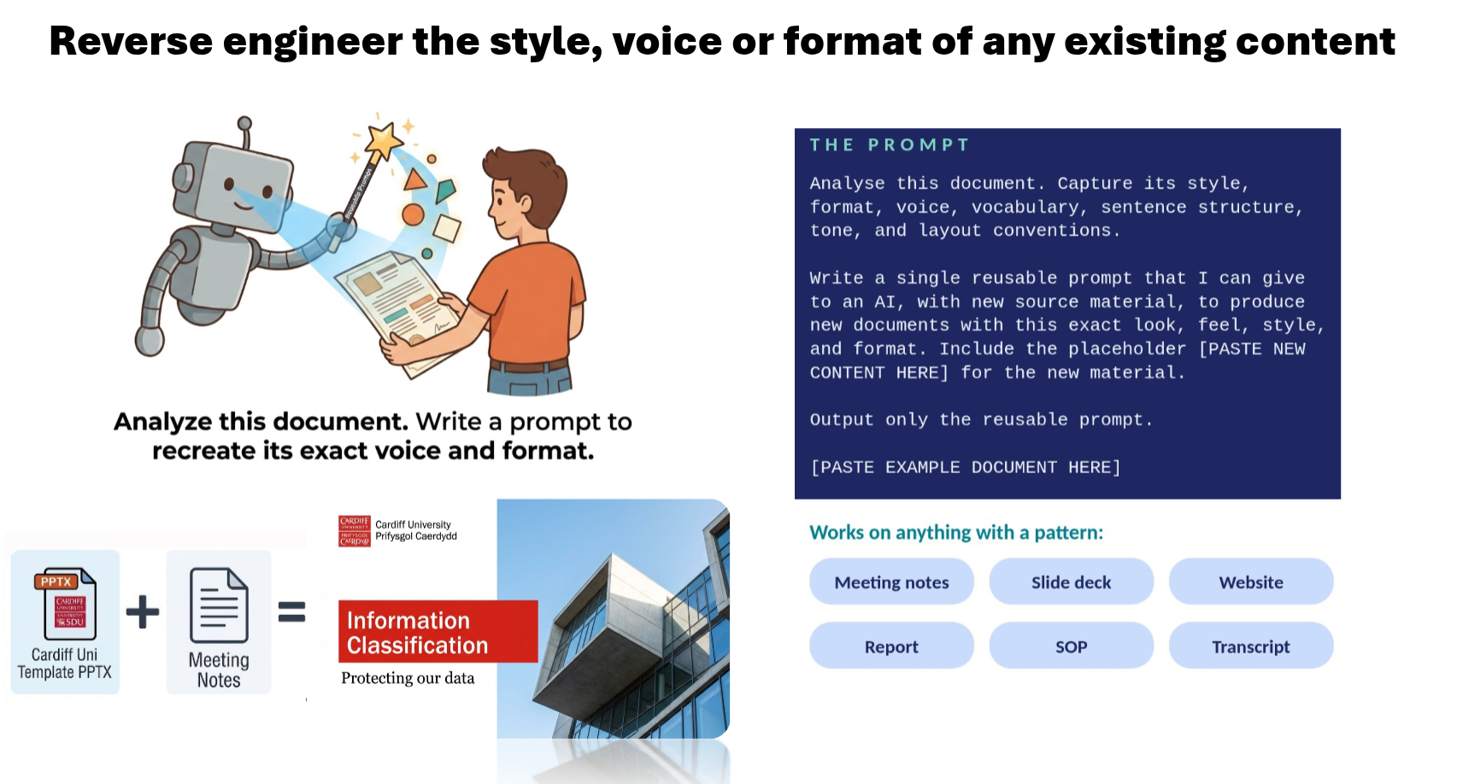

Slide 38
Will show following as a live demo

Slide 39
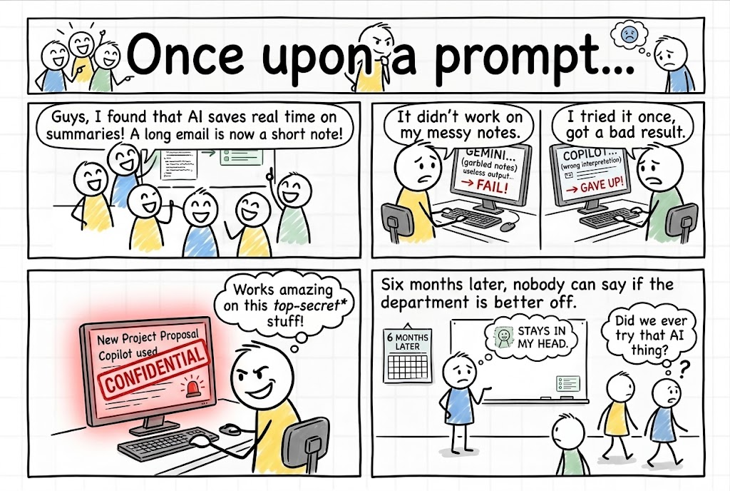

Slide 40
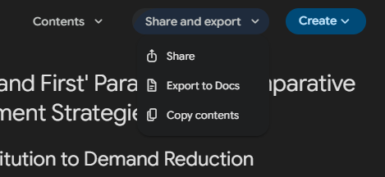
Deep research
Share and export:
Share (generate a web address)
Export to (google)docs
Copy contents

Slide 41
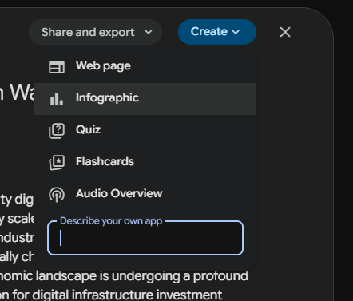
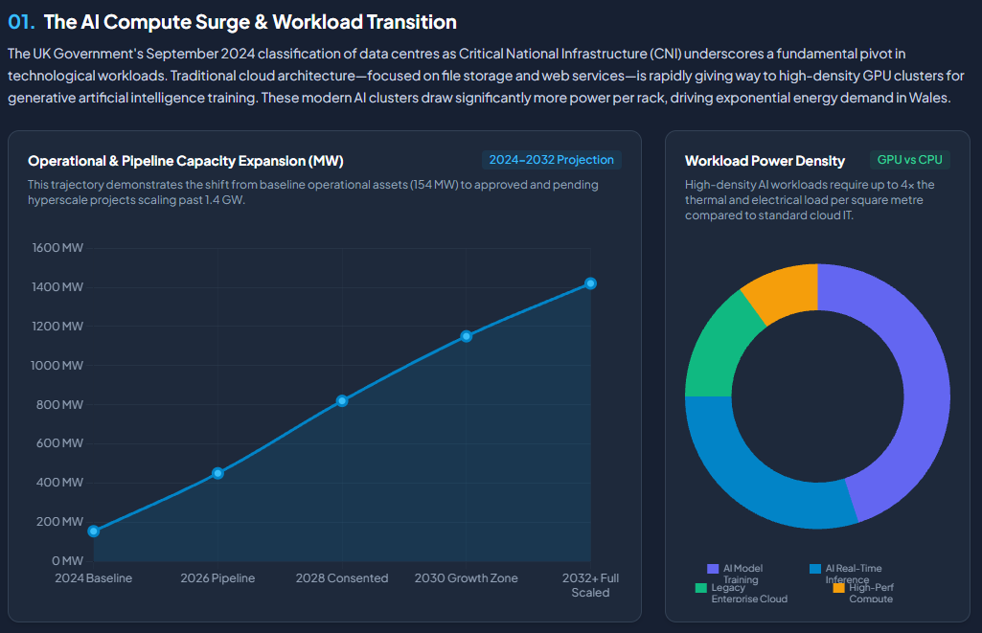
Deep research
Optional extras:
Web-pages
Infographics
Quizzes
Flashcards
Audio overviews

Slide 42
Canvas
"Please review the attached 'Sustainable Futures' document. I would like you to create a playable 8-bit web game in a single HTML file using JavaScript and CSS. The visual style must mimic a vintage ZX Spectrum game with a black background and bright, blocky neon colours.The player controls a pixelated character who must cross a busy university dining hall. The goal is to collect low-impact foods to score points, while dodging high-carbon items moving rapidly across the screen. If you hit a high-carbon item, you lose a life.Crucially, use specific terminology, quotes, or policy goals directly from the attached document for the game's title, the introductory screen text, and the 'game over' messages. For example, you could name the game after one of the core goals or reference the 'Demand First' principle in the instructions. Please make it fully playable with keyboard arrow keys.."

